Slide 1

For Absolute Beginner
TOP ECE Review Center
Engr. Darwin M. Tacubanza, ECE

Slide 2


Course Outline
TOP ECE Review Center

Slide 3
Course Outline
Setup the Python Programming Environment
Python Basics
Python Data Types
Flow Control
Functions

Slide 4
What is Python?

Slide 5

Python
Python is an interpreted, high-level, general-purpose programming language with easy syntax and dynamic semantics
Created by Guido Von Rossum in 1989

Slide 6
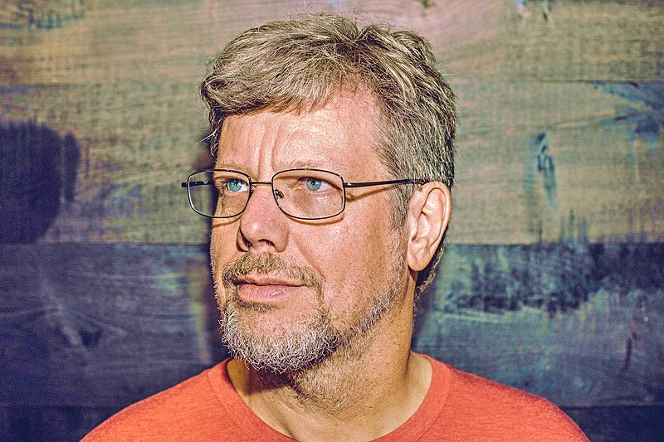
Creator of Python
Guido von Rossum, a Dutch programmer
“Benevolent Dictator For Life” (BDFL)
Announced his permanent vacation in July 12, 2018
But still a member of the 5-member “Steering Council” leading the Python Community

Slide 7
Who Uses Python?

Slide 8
What is Python used for?

Slide 9
Python Uses
Python is a multi-purpose programming language that is used by many different professionals.
And is used for so many different disciplines.

Slide 10

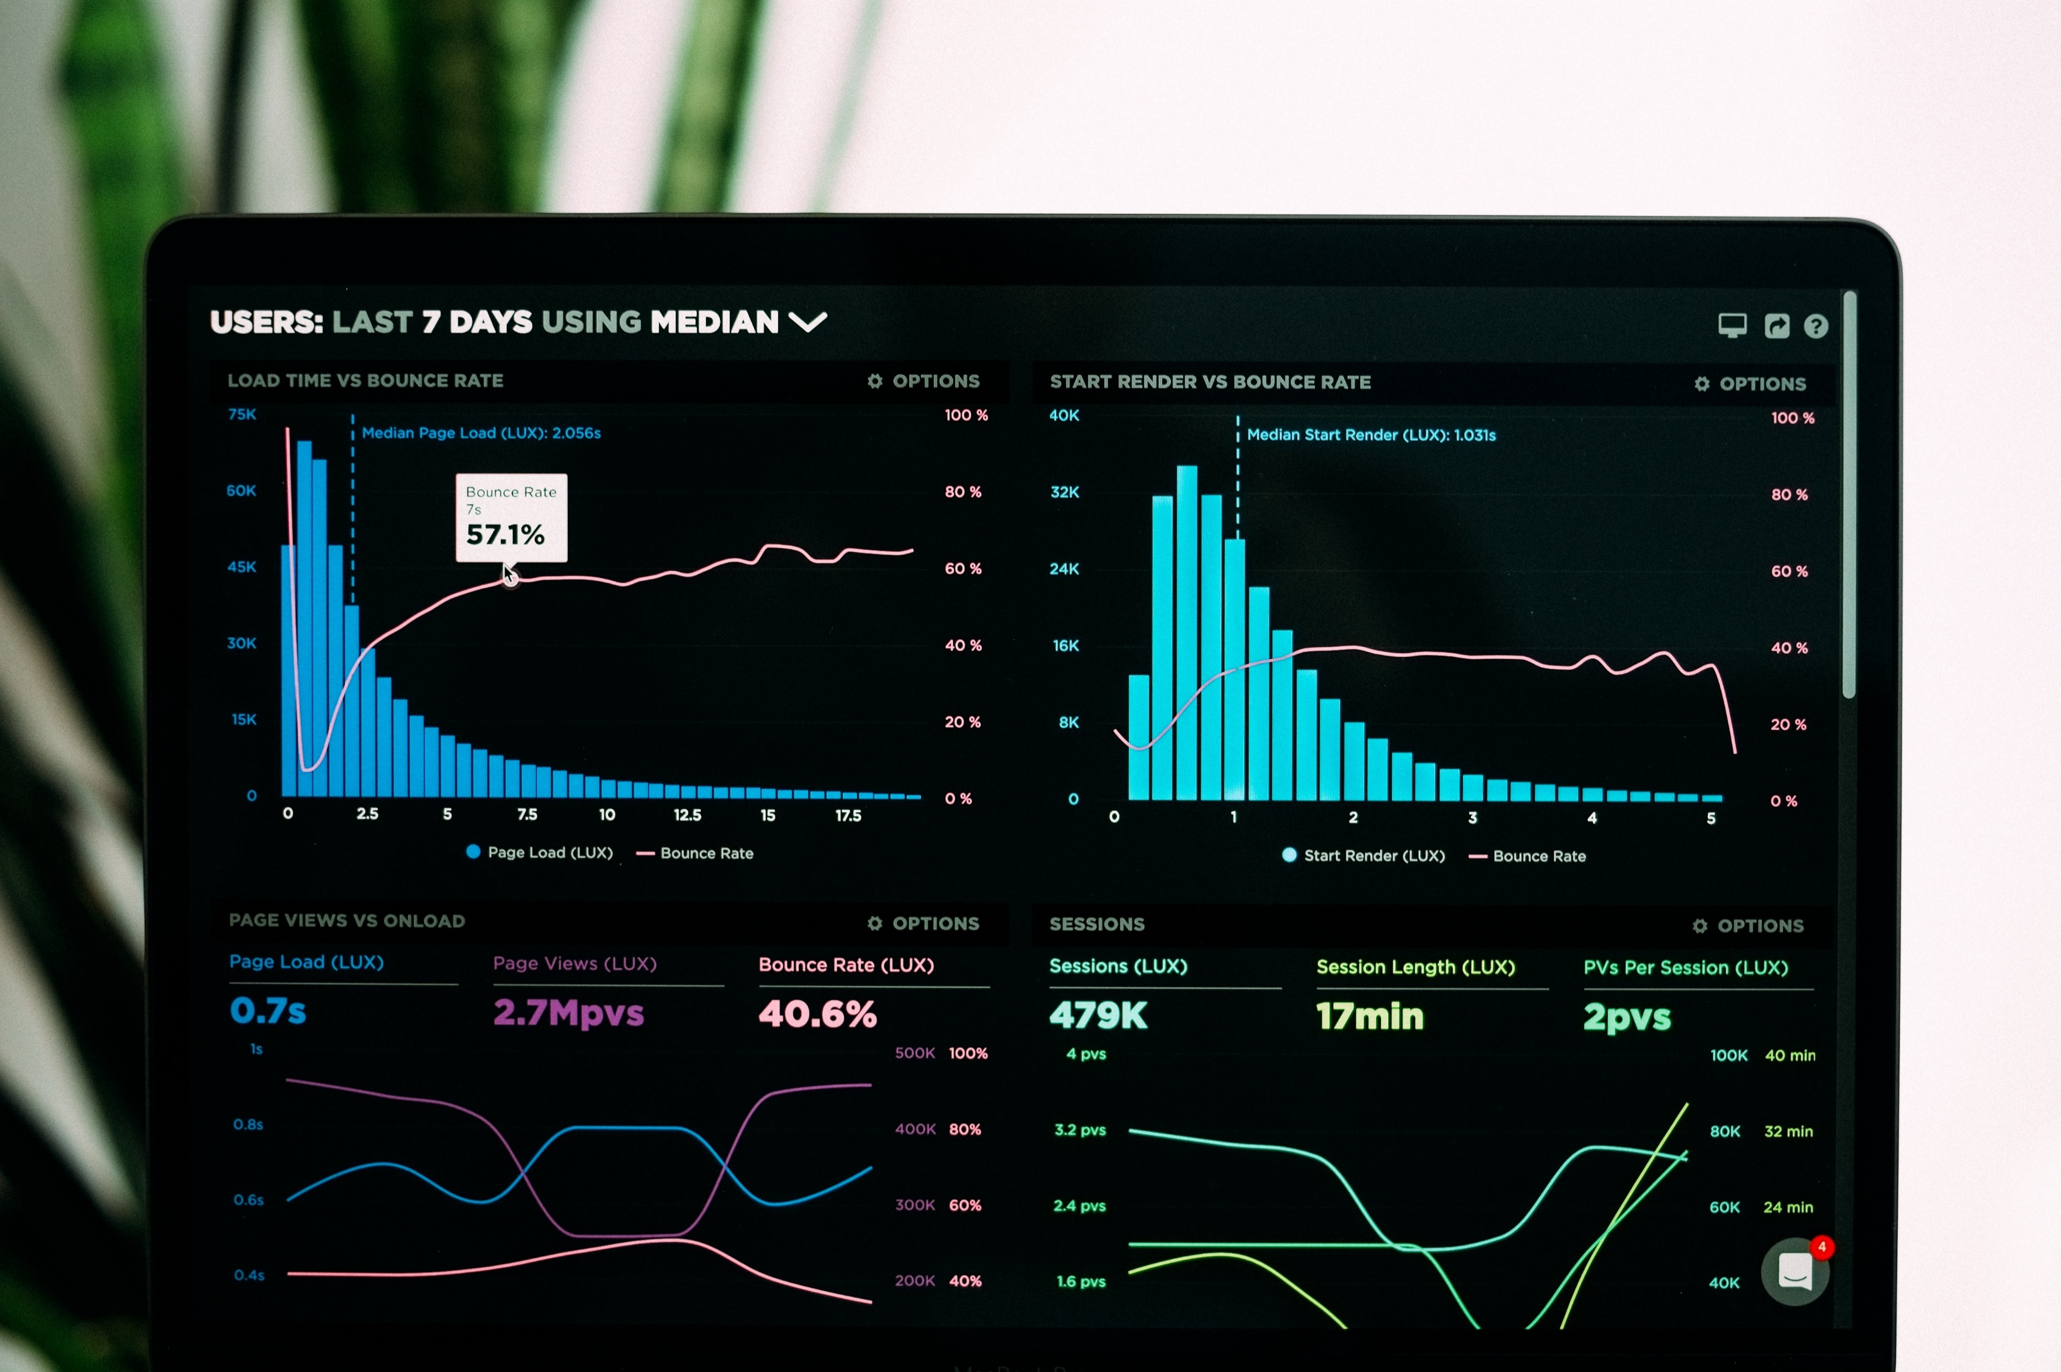
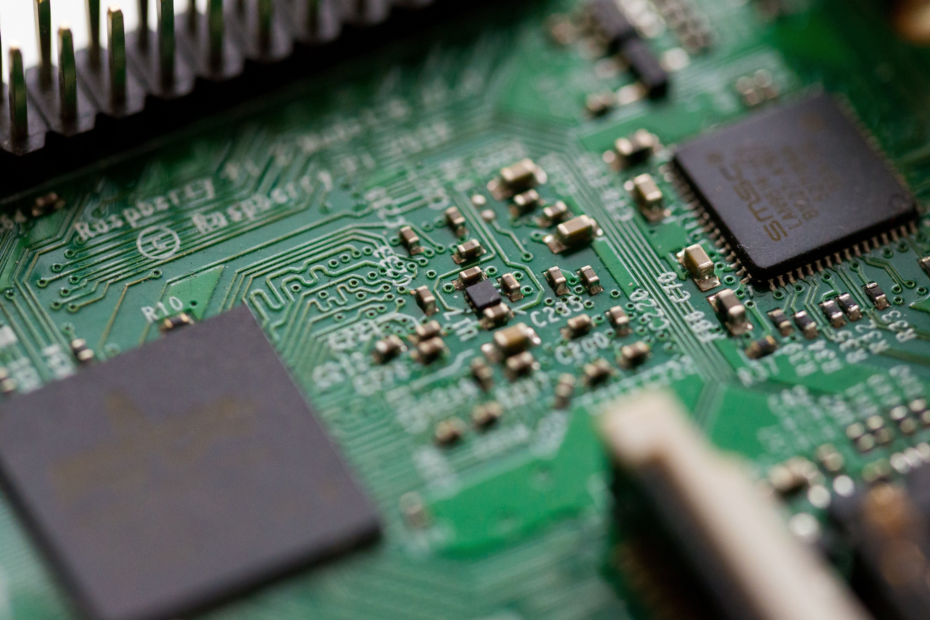


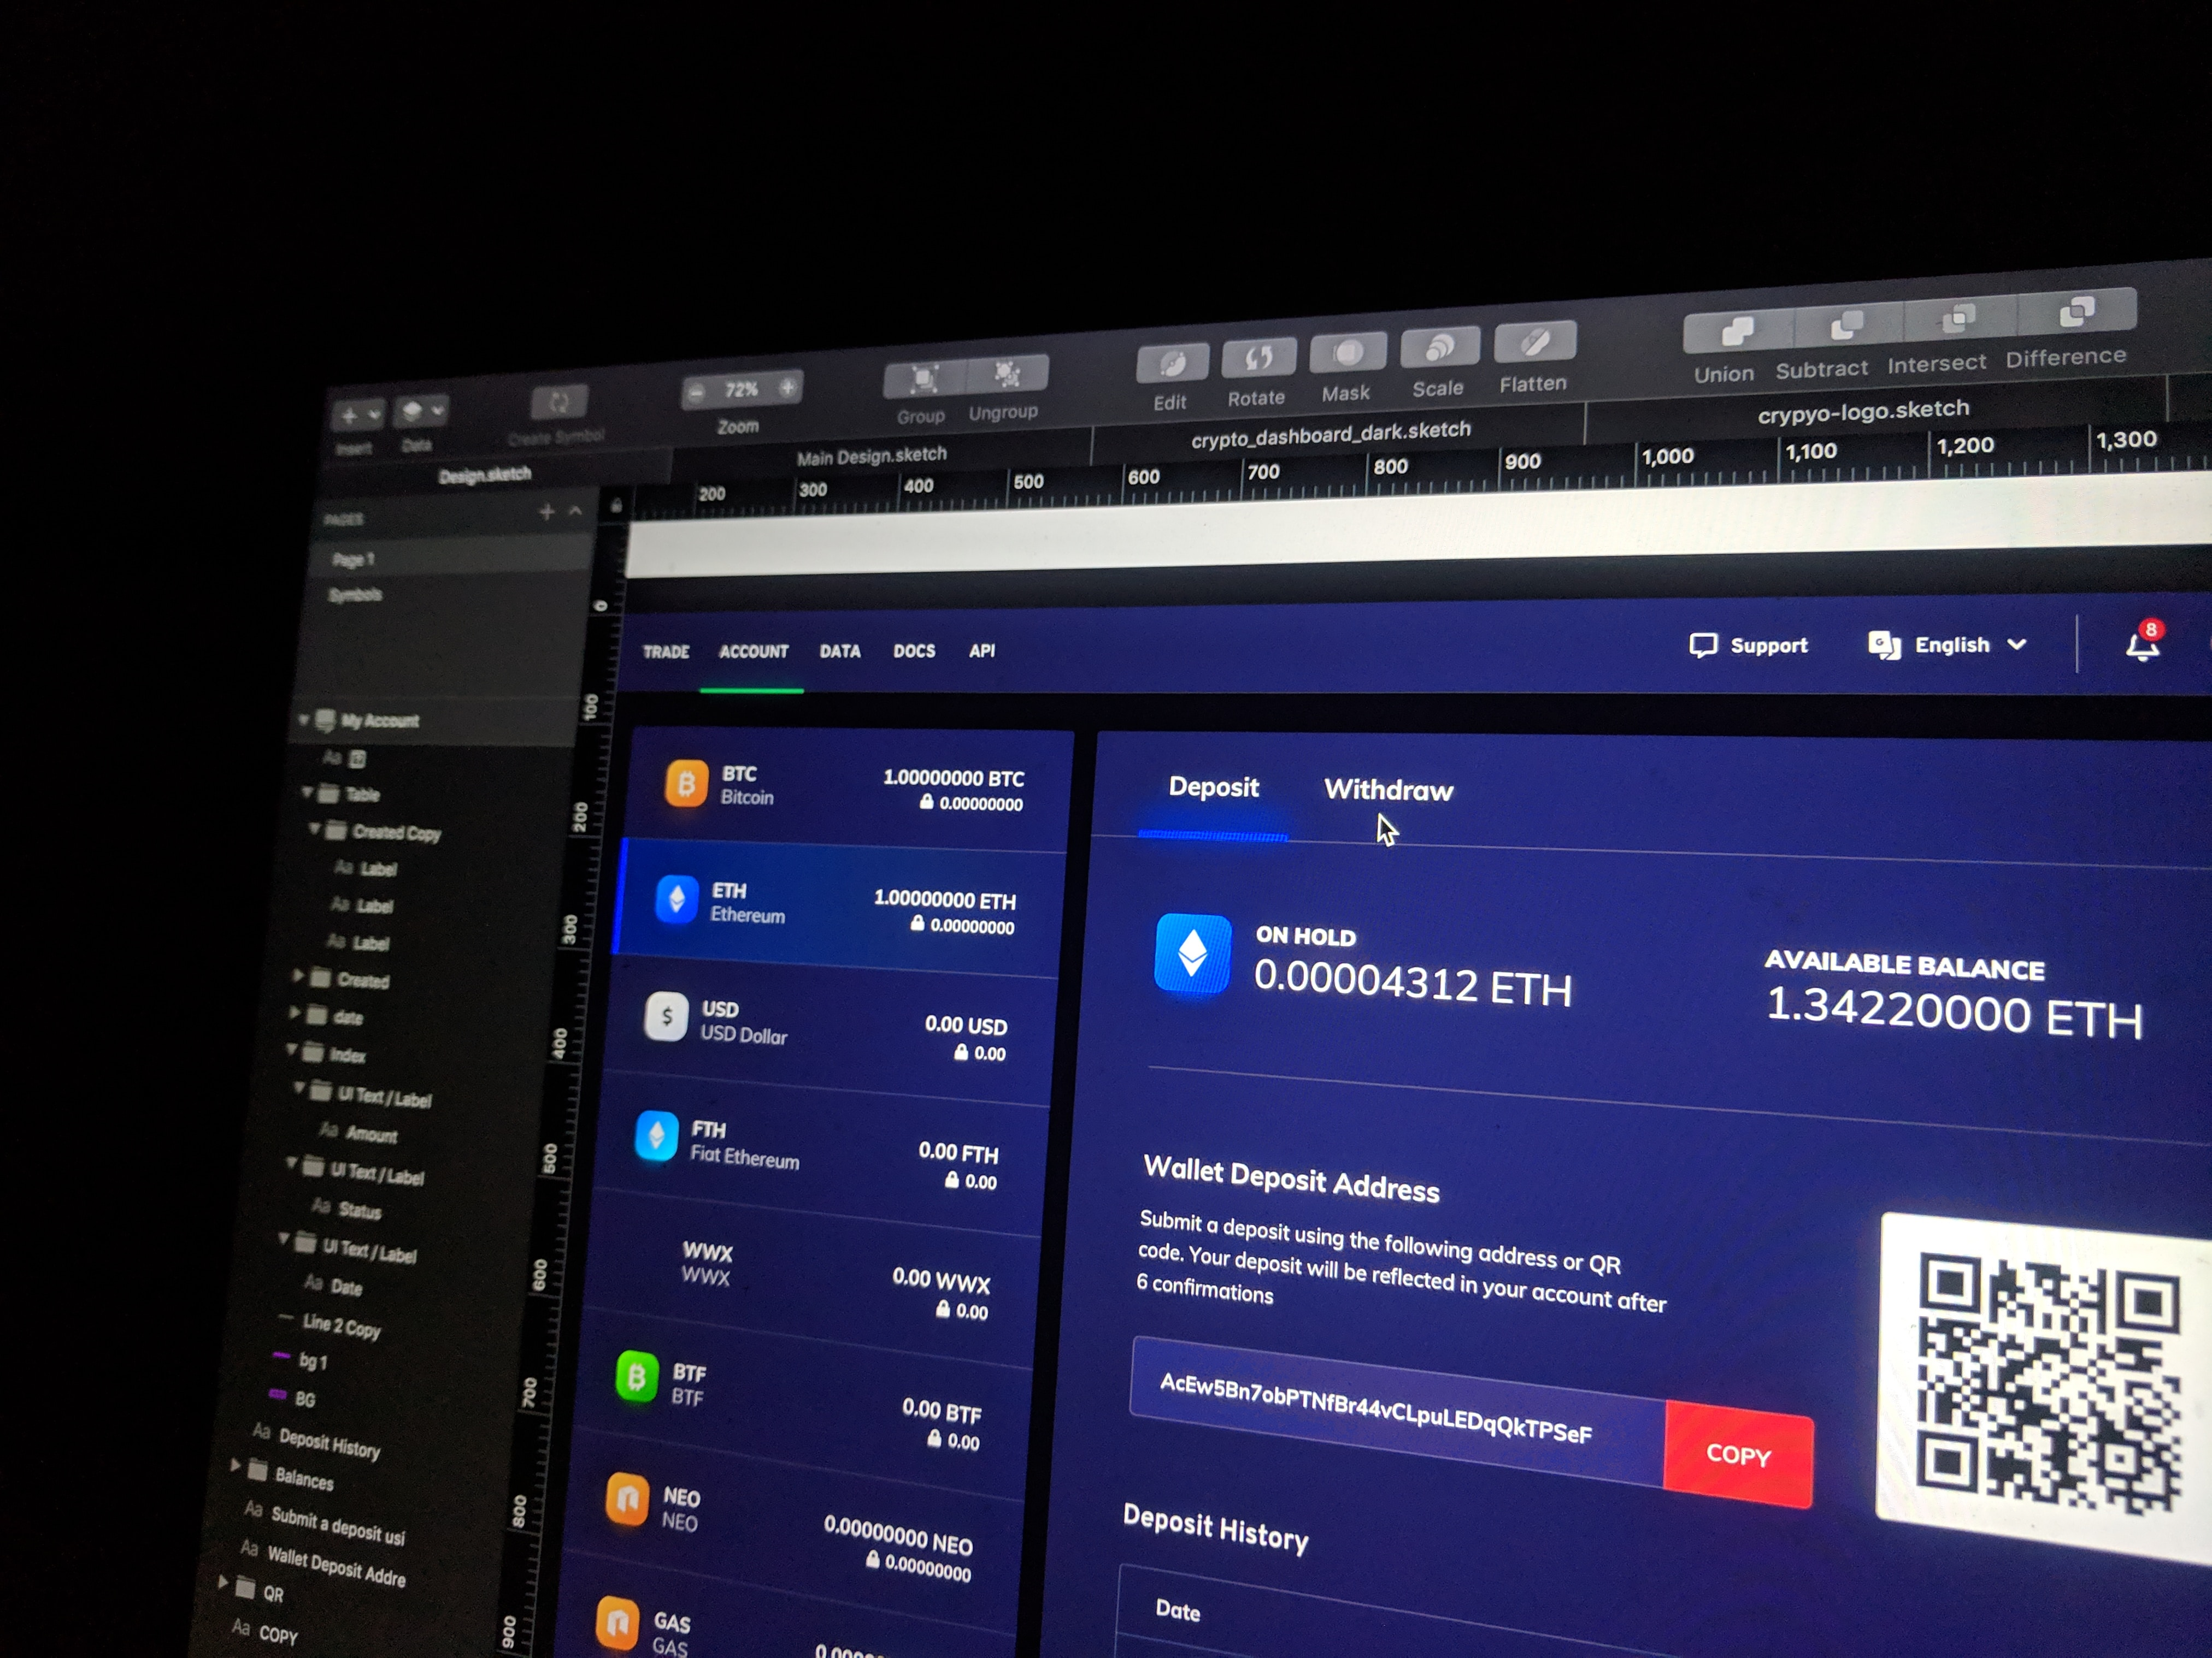
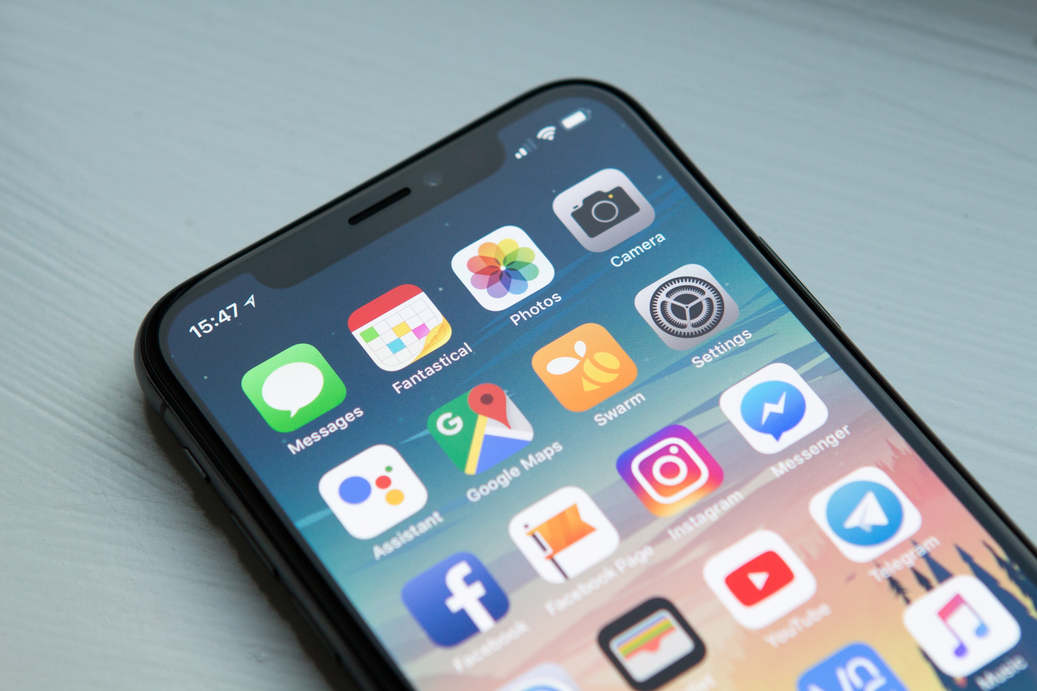

What can you do with Python?
Automation
Data Visualization
Electronics
Desktop Apps
Hacking
Web Apps
Mobile Apps
Machine Learning

Slide 11
Why Python?
Advantages of Python

Slide 12
Advantages of Python
Easy to use
Free
Multi-purpose
High-level
Cross-platform
Huge community
Large Ecosystem
Less time, fewer lines in coding

Slide 13
Setup the Python Programming Environment
TOP ECE Review Center

Slide 14
What will you learn?
Download Python Installer
Install Python
Test Python
Integrated Development Environment (IDE)
Download and Install Sublime Text 3
Create and Save Files
‘Hello World’
Command Prompt
Learn Python’s IDE

Slide 15
For Absolute Beginner
TOP ECE Review Center
Engr. Darwin M. Tacubanza, ECE

